Slide 1
DISCLAIMER
This case study is based on a hypothetical cab booking system for educational purposes.
This project aims to highlight the importance of SQL in data analysis and demonstrate how SQL queries work in practice.
Data used in the analysis may not represent real-world business scenarios.

Slide 2

Case Study:
Cab Booking System for Data Analysis
Analyzing Customer Behavior, Driver Performance, and Business Metrics
Presented by: Tahiruddin
Date: 20/02/2025 (Thursday)

Slide 3
Introduction
Overview:
Cab booking systems generate vast amounts of data related to customers, drivers, and trips.
SQL helps in extracting valuable insights from this data for business decisions.
Purpose:
Understand customer booking patterns
Evaluate driver performance
Analyze business metrics like revenue trends

Slide 4
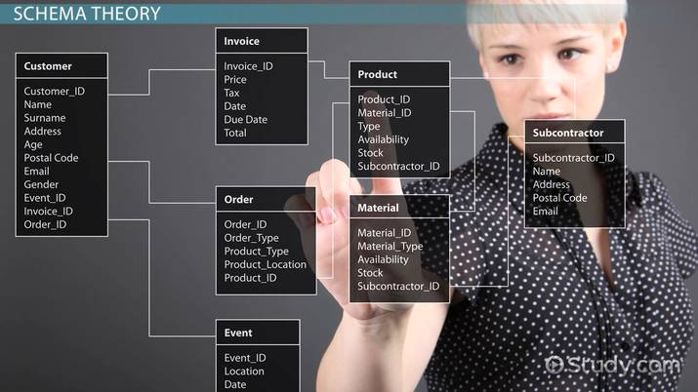
Database Schema
Tables in the system:
Customers (CustomerID, Name, Email, Phone, RegistrationDate)
Drivers (DriverID, Name, Email, Phone, LicenseNumber, Rating, VehicleType)
Cabs (CabID, VehicleType, LicensePlate, DriverID)
Bookings (BookingID, CustomerID, CabID, BookingDate, DropoffLocation, PickupLocation, Fare)
TripDetails (TripID, BookingID, StartTime, EndTime, Distance, TripFare)
Feedback (FeedbackID, CustomerID, DriverID, BookingID, Rating, Comments, FeedbackDate)
Customers
Drivers
Cabs
Cab_Booking_System
Bookings
TripDetails
Feedback

Slide 5
SQL Query Tasks Overview
Key SQL tasks for analysis:
Creating tables
Inserting data
Filtering and searching records
Aggregating and grouping data
Joining tables for deeper insights
Using advanced queries for complex analysis

Slide 6
Creating Tables
SQL Queries that are must to create tables in are database.

Slide 7
Customers
Drivers
Cabs
Bookings
TripDetails
Feedback
CREATE TABLE Customers ( CustomerID INT PRIMARY KEY AUTO_INCREMENT, FirstName VARCHAR(50) NOT NULL, LastName VARCHAR(50) NOT NULL, Email VARCHAR(100) UNIQUE NOT NULL, Phone VARCHAR(15) UNIQUE NOT NULL, RegistrationDate DATE NOT NULL);
CREATE TABLE Drivers ( DriverID INT PRIMARY KEY AUTO_INCREMENT, FirstName VARCHAR(50) NOT NULL, LastName VARCHAR(50) NOT NULL, Email VARCHAR(100) UNIQUE NOT NULL, Phone VARCHAR(15) UNIQUE NOT NULL, LicenseNumber VARCHAR(20) UNIQUE NOT NULL, VehicleType VARCHAR(20) NOT NULL, Rating DECIMAL(3,2) CHECK (Rating BETWEEN 0 AND 5) DEFAULT 0);
CREATE TABLE Cabs ( CabID INT PRIMARY KEY AUTO_INCREMENT, DriverID INT UNIQUE NOT NULL, LicensePlate VARCHAR(20) UNIQUE NOT NULL, VehicleType VARCHAR(20) NOT NULL, FOREIGN KEY (DriverID) REFERENCES Drivers(DriverID) ON DELETE CASCADE);
CREATE TABLE Bookings ( BookingID INT PRIMARY KEY AUTO_INCREMENT, CustomerID INT NOT NULL, CabID INT NOT NULL, BookingDate DATE NOT NULL, PickupLocation VARCHAR(255) NOT NULL, DropoffLocation VARCHAR(255) NOT NULL, Fare DECIMAL(10,2) NOT NULL, Status VARCHAR(20) CHECK (Status IN ('Completed', 'Cancelled', 'In Progress')) NOT NULL, FOREIGN KEY (CustomerID) REFERENCES Customers(CustomerID) ON DELETE CASCADE, FOREIGN KEY (CabID) REFERENCES Cabs(CabID) ON DELETE CASCADE);
CREATE TABLE TripDetails ( TripID INT PRIMARY KEY AUTO_INCREMENT, BookingID INT NOT NULL UNIQUE, StartTime DATETIME NOT NULL, EndTime DATETIME, Distance DECIMAL(10,2) NOT NULL CHECK (Distance >= 0), TripFare DECIMAL(10,2) NOT NULL CHECK (TripFare >= 0), FOREIGN KEY (BookingID) REFERENCES Bookings(BookingID) ON DELETE CASCADE);
CREATE TABLE Feedback ( FeedbackID INT PRIMARY KEY AUTO_INCREMENT, BookingID INT NOT NULL, CustomerID INT NOT NULL, DriverID INT NOT NULL, Rating DECIMAL(3,2) CHECK (Rating BETWEEN 0 AND 5) NOT NULL, Comments TEXT, FeedbackDate DATE NOT NULL, FOREIGN KEY (BookingID) REFERENCES Bookings(BookingID) ON DELETE CASCADE, FOREIGN KEY (CustomerID) REFERENCES Customers(CustomerID) ON DELETE CASCADE, FOREIGN KEY (DriverID) REFERENCES Drivers(DriverID) ON DELETE CASCADE);

Slide 8
Feedback
FeedbackID
BookingID
CustomerID
DriverID
Rating
Comments
FeedbackDate
Drivers
DriverID
FirstName
LastName
Email
Phone
LicenseNumber
VehicleType
Rating
Visual Representation of Relation between the Tables
CustomerID
CustomerID
DriverID
DriverID
Inserted Records Details
Customers
customerID
FirstName
LastName
Email
Phone
RegistrationDate
Example SQL Insert Query :
For the Analysis of the Case Study: Cab Booking System, we have recorded 35 dummy Customers data and 17 dummy Drivers data, on which the analysis will takes place for our better understanding.
Here’s is the example of a SQL Query, so that we can understand how we can INSERT data into database’s tables.
INSERT INTO Customers (CustomerID, Name, Email, Phone, SignupDate)
VALUES (1, 'John Doe', 'john@example.com', '1234567890', '2023-01-15');
Bookings
BookingID
CustomerID
CabID
BookingDate
PickupLocation
DropoffLocation
Fare
TripDetails
TripID
BookingID
StartTime
EndTime
Distance
TripFare
Cabs
CabID
DriverID
LicensePlate
VehicleType
BookingID
CabID
BookingID

Slide 9
Visual Representation of Relation between the Tables
Customers
customerID
FirstName
LastName
Email
Phone
RegistrationDate
Feedback
FeedbackID
BookingID
CustomerID
DriverID
Rating
Comments
FeedbackDate
Drivers
DriverID
FirstName
LastName
Email
Phone
LicenseNumber
VehicleType
Rating
CustomerID
DriverID
CustomerID
BookingID
TripDetails
TripID
BookingID
StartTime
EndTime
Distance
TripFare
DriverID
Bookings
BookingID
CustomerID
CabID
BookingDate
PickupLocation
DropoffLocation
Fare
Cabs
CabID
DriverID
LicensePlate
VehicleType
CabID
BookingID

Slide 10
What are the Bookings where status is “In Progress”?
To counter this question we had to run the following SQL query to Analise the data for bookings which are ‘In Progress’.

Slide 11
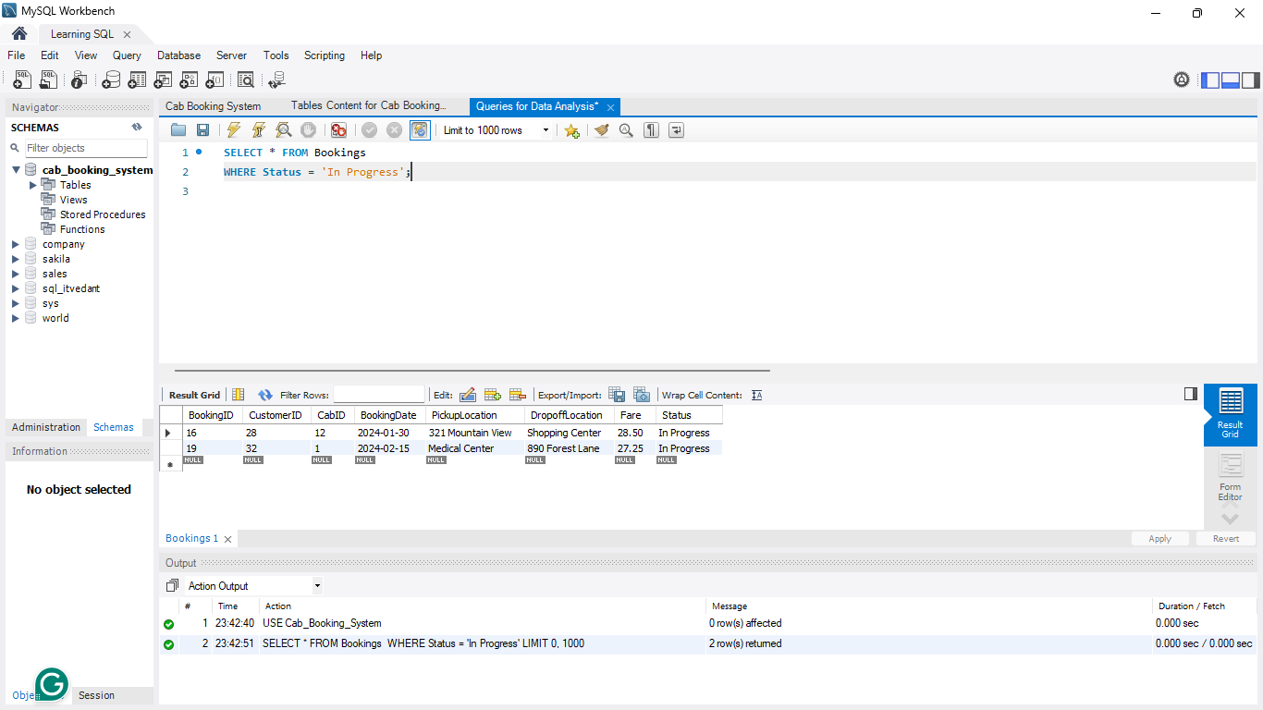
SQL query to retrieve all bookings where the status is 'In Progress’:
SELECT * FROM Bookings
WHERE Status = 'In Progress';
SELECT *
This means select all columns from the table.

Slide 12
SQL query to retrieve all bookings where the status is 'In Progress’:
SELECT * FROM Bookings
WHERE Status = 'In Progress';
FROM Bookings
SELECT *
This means select all columns from the table.
Specifies that the data should be retrieved from the Bookings table.

Slide 13
SQL query to retrieve all bookings where the status is 'In Progress’:
SELECT * FROM Bookings
WHERE Status = 'In Progress';
FROM Bookings
WHERE Status = 'In Progress'
SELECT *
This means select all columns from the table.
Specifies that the data should be retrieved from the Bookings table.
Filters the results to only include bookings where the Status is 'In Progress'.

Slide 14
Insights After running the Query:
Only 2 bookings have the status "In Progress“ :
Booking ID 16: Cab ID 12, traveling from 321 Mountain View → Shopping Center.
Booking ID 19: Cab ID 1, traveling from Medical Center → 890 Forest Lane.
This helps in real-time tracking, operational efficiency, and customer updates.

Slide 15
What are the Cabs whose Vehicle is “Sedan” having the Driver ID 5?
To counter this question we had to run the following SQL query to Analise the ‘Sedan’ Cabs with Driver ID 5.

Slide 16
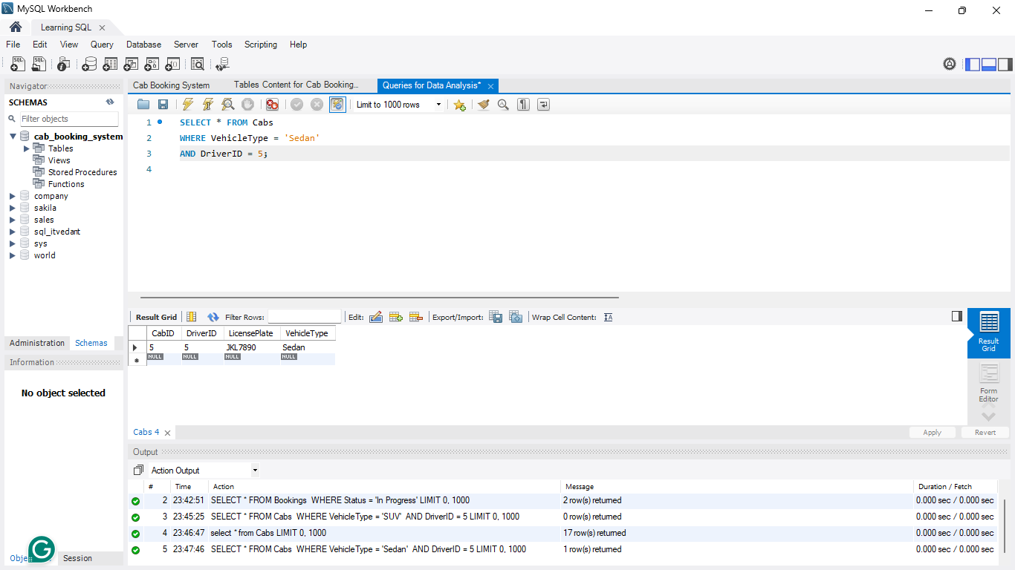
SQL query to retrieve all cabs where the VehicleType is ‘Sedan’ and the DriverID is 5:
SELECT * FROM Cabs
WHERE VehicleType = ‘Sedan’
AND DriverID = 5;
FROM Bookings
WHERE VehicleType = ‘Sedan’
SELECT *
This means select all columns from the table.
Specifies that the data should be retrieved from the Cabs table.
Filters the results to only include Cabs where the VehicleType is ‘Sedan’.

Slide 17
SQL query to retrieve all cabs where the VehicleType is ‘Sedan’ and the DriverID is 5:
SELECT * FROM Cabs
WHERE VehicleType = ‘Sedan’
AND DriverID = 5;
WHERE VehicleType = ‘Sedan’
SELECT *
FROM Bookings
This means select all columns from the table.
Specifies that the data should be retrieved from the Cabs table.
Filters the results to only include Cabs where the VehicleType is ‘Sedan’.

Slide 18
SQL query to retrieve all cabs where the VehicleType is ‘Sedan’ and the DriverID is 5:
SELECT * FROM Cabs
WHERE VehicleType = ‘Sedan’
AND DriverID = 5;
SELECT *
FROM Bookings
WHERE VehicleType = ‘Sedan’
This means select all columns from the table.
Specifies that the data should be retrieved from the Cabs table.
Filters the results to only include Cabs where the VehicleType is ‘Sedan’.

Slide 19
SQL query to retrieve all cabs where the VehicleType is ‘Sedan’ and the DriverID is 5:
SELECT * FROM Cabs
WHERE VehicleType = ‘Sedan’
AND DriverID = 5;
SELECT *
FROM Bookings
WHERE VehicleType = ‘Sedan’
AND DriverID = 5
This means select all columns from the table.
Further filters the results to include only cabs assigned to DriverID = 5.
Specifies that the data should be retrieved from the Cabs table.
Filters the results to only include Cabs where the VehicleType is ‘Sedan’.

Slide 20
Insights After running the Query:
DriverID 5 has only one “Sedan” cab (Cab ID 5) in the dataset.
Its license plate number is "JKL7890".
This suggests a limited fleet diversity, which could impact customer preferences for vehicle types.

Slide 21
Name the Customers whose last name is “Smith”?
To counter this question we had to run the following SQL query to Analise the names of the our customers whose last name if “Smith”.

Slide 22
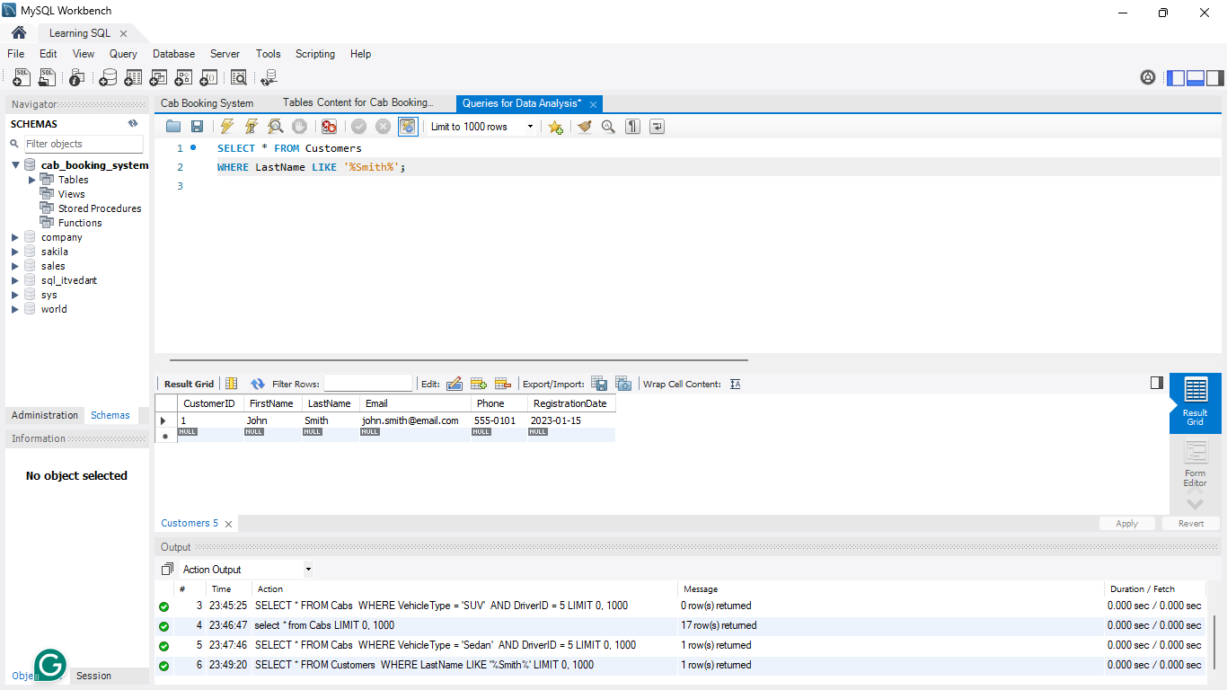
SQL query to select all Customers whose LastName contains ‘Smith’:
SELECT * FROM Customers
WHERE LastName LIKE ‘%Smith%’;
FROM Bookings
WHERE VehicleType = ‘Sedan’
SELECT *
The query is retrieving data from the Customers table.
Specifies that the data should be retrieved from the Cabs table.
Filters the results to only include Cabs where the VehicleType is ‘Sedan’.

Slide 23
SQL query to select all Customers whose LastName contains ‘Smith’:
SELECT * FROM Customers
WHERE LastName LIKE ‘%Smith%’;
FROM Customers
WHERE VehicleType = ‘Sedan’
SELECT *
The query is retrieving data from the Customers table.
Specifies that the data should be retrieved from the Customers table.
Filters the results to only include Cabs where the VehicleType is ‘Sedan’.

Slide 24
SQL query to select all Customers whose LastName contains ‘Smith’:
SELECT * FROM Customers
WHERE LastName LIKE ‘%Smith%’;
FROM Customers
WHERE LastName Like ‘%Smith%’
SELECT *
The query is retrieving data from the Customers table.
Specifies that the data should be retrieved from the Customers table.
finds any LastName that contains "Smith", as the % symbols are wildcards representing any number of characters before and after "Smith".

Slide 25
Insights After running the Query:
Only one customer in the dataset has the last name "Smith": John Smith.
This is an interesting data point but not significant for overall business decisions unless used for personalized marketing.

Slide 26
What is the fare status in Bookings? We consider that the fare above the $50 is ‘High’ otherwise it’s ‘Low’.
To counter this question we had to run the following SQL query to Analise the fare of the bookings where it is ‘High’ or ‘Low’.

Slide 27
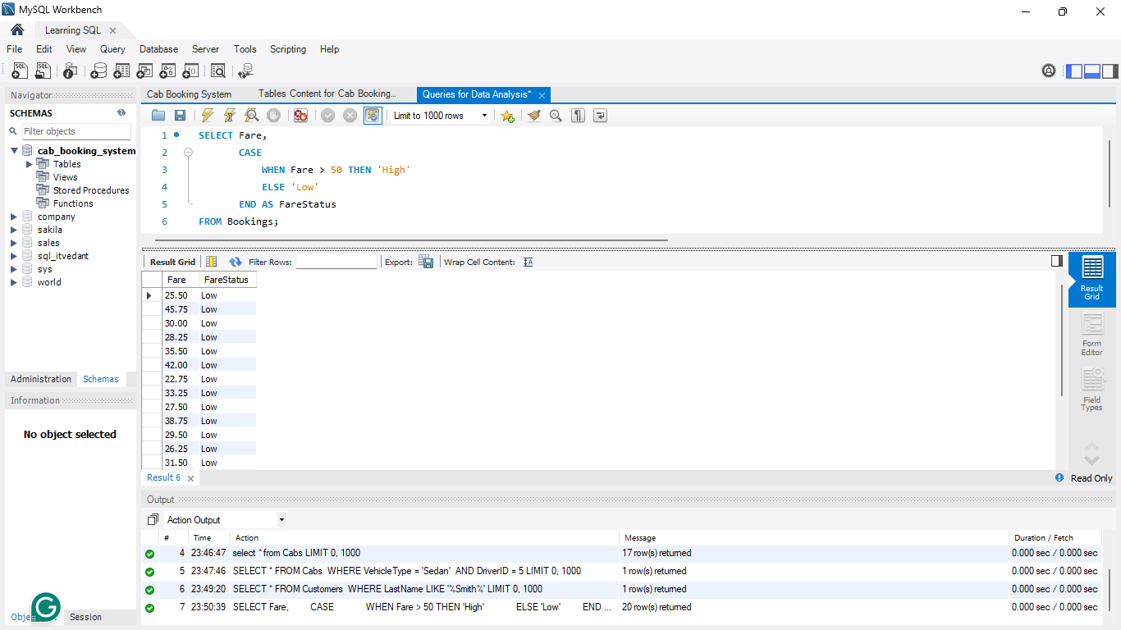
SQL query to select all Fare from the Bookings along with new column FareStatus:
SELECT Fare,
CASE
WHEN Fare > 50 THEN 'High'
ELSE 'Low'
END AS FareStatus
FROM Bookings;
FROM Bookings
WHERE VehicleType = ‘Sedan’
CASE
The case statement checks the value of the Fare column.
Specifies that the data should be retrieved from the Cabs table.
Filters the results to only include Cabs where the VehicleType is ‘Sedan’.

Slide 28
SQL query to select all Fare from the Bookings along with new column FareStatus:
SELECT Fare,
CASE
WHEN Fare > 50 THEN 'High'
ELSE 'Low'
END AS FareStatus
FROM Bookings;
WHERE VehicleType = ‘Sedan’
CASE
WHEN Fare>50 THEN ‘High’ ELSE ‘Low’
The case statement checks the value of the Fare column.
If Fare is greater than 50, it assigns ‘High’ otherwise, it assigns ‘Low’.
Filters the results to only include Cabs where the VehicleType is ‘Sedan’.

Slide 29
SQL query to select all Fare from the Bookings along with new column FareStatus:
SELECT Fare,
CASE
WHEN Fare > 50 THEN 'High'
ELSE 'Low'
END AS FareStatus
FROM Bookings;
CASE
WHEN Fare>50 THEN ‘High’ ELSE ‘Low’
END AS FareStatus
The case statement checks the value of the Fare column.
Returns the result in the column named as FareStatus.
If Fare is greater than 50, it assigns ‘High’ otherwise, it assigns ‘Low’.

Slide 30
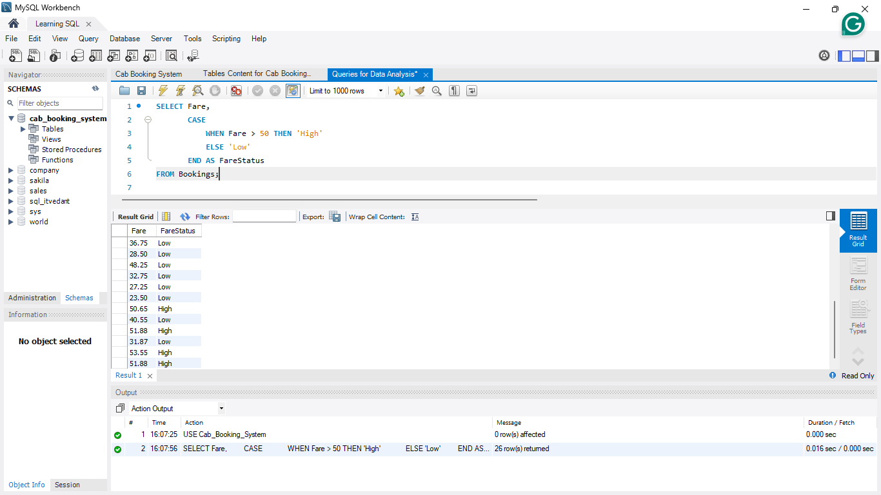
Insights After running the Query:
Only 4 records have a "High" fare status.
Indicates that most fares are within a moderate range, or pricing strategies may need to be adjusted for profitability.

Slide 31
Who are the drivers whose ratings are higher than average rating?
To counter this question we had to run the following SQL query to Analise the ratings of the diver which are higher than the average rating.

Slide 32
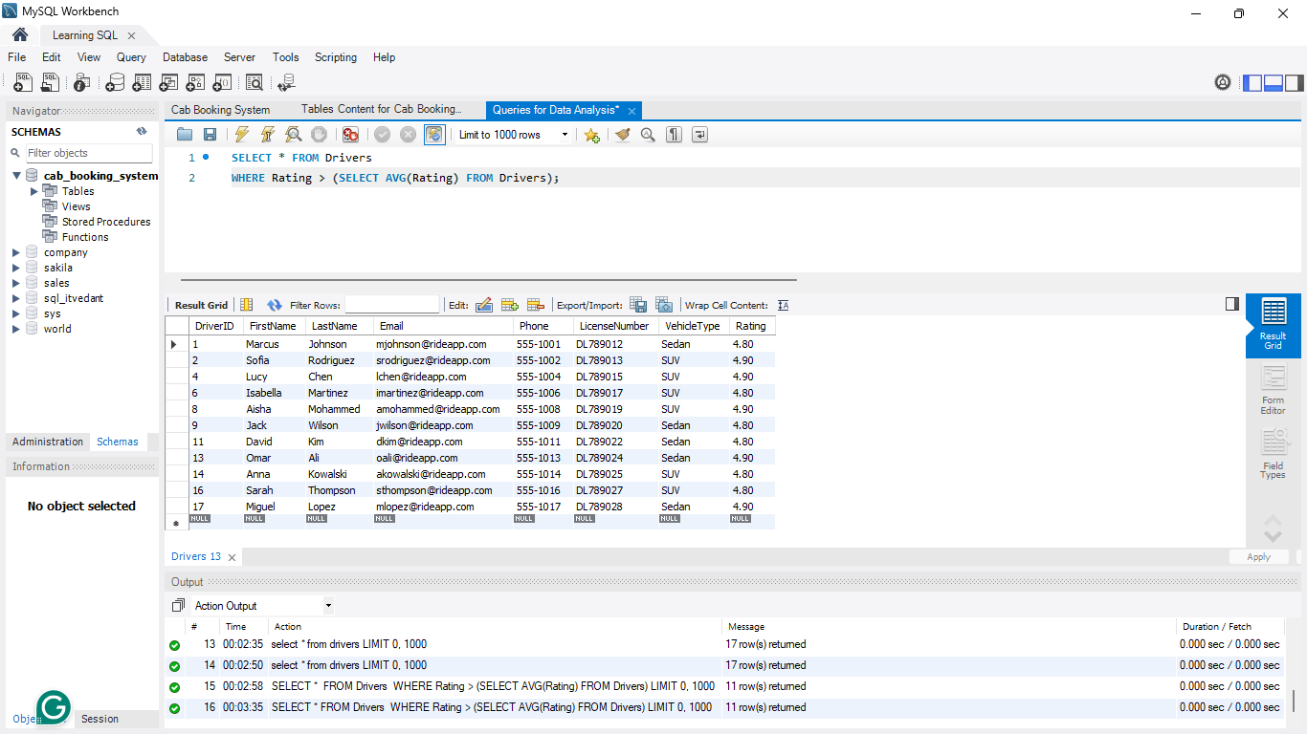
SQL query to retrieve all drivers who have received a rating higher than the average rating of all drivers:
SELECT * FROM Drivers
WHERE Rating > (SELECT AVG(Rating) FROM Drivers);
Query Explanation:

Slide 33
SQL query to retrieve all drivers who have received a rating higher than the average rating of all drivers:
SELECT * FROM Drivers
WHERE Rating > (SELECT AVG(Rating) FROM Drivers);
The subquery (SELECT AVG(Rating) FROM Drivers) calculates the average rating of all drivers.
Query Explanation:

Slide 34
SQL query to retrieve all drivers who have received a rating higher than the average rating of all drivers:
SELECT * FROM Drivers
WHERE Rating > (SELECT AVG(Rating) FROM Drivers);
The subquery (SELECT AVG(Rating) FROM Drivers) calculates the average rating of all drivers.
Query Explanation:
The outer query selects all drivers whose Rating is greater than the average.

Slide 35
Insights After running the Query:
Identifying drivers who received higher ratings than the average driver rating.
Helps in performance evaluation and setting customer service benchmarks.

Slide 36
What are the total fare collected by each driver?
To counter this question we had to run the following SQL query to Analise the fare collection of drivers.

Slide 37
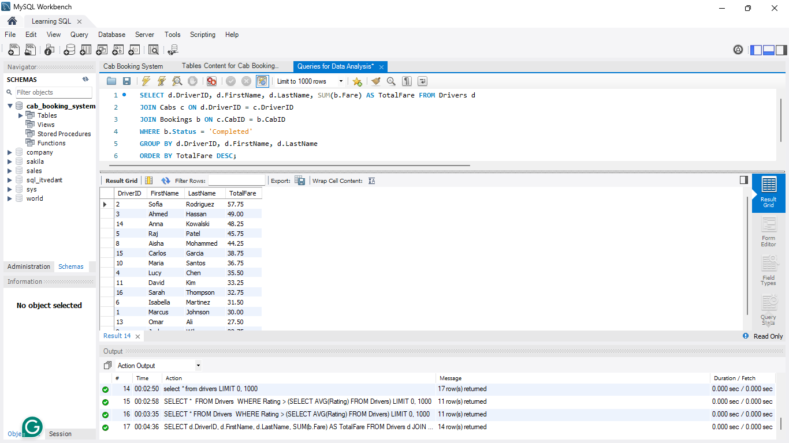
SQL query to get the total fare collected by each driver:
SELECT d.DriverID, d.FirstName, d.LastName, SUM(b.Fare) AS TotalFare
FROM Drivers d
JOIN Cabs c ON d.DriverID = C.DriverID
JOIN Bookings b ON c.CabID = b.CabID
WHERE b.Status = ‘Completed’
GROUP BY d.DriverID, d.FirstName, d.LastName
ORDER BY TotalFare DESC;
Query Explanation:

Slide 38
SQL query to get the total fare collected by each driver:
SELECT d.DriverID, d.FirstName, d.LastName, SUM(b.Fare) AS TotalFare
FROM Drivers d
JOIN Cabs c ON d.DriverID = C.DriverID
JOIN Bookings b ON c.CabID = b.CabID
WHERE b.Status = ‘Completed’
GROUP BY d.DriverID, d.FirstName, d.LastName
ORDER BY TotalFare DESC;
We join Drivers, Cabs, and Bookings to connect drivers with their cab bookings.
Query Explanation:

Slide 39
SQL query to get the total fare collected by each driver:
SELECT d.DriverID, d.FirstName, d.LastName, SUM(b.Fare) AS TotalFare
FROM Drivers d
JOIN Cabs c ON d.DriverID = C.DriverID
JOIN Bookings b ON c.CabID = b.CabID
WHERE b.Status = ‘Completed’
GROUP BY d.DriverID, d.FirstName, d.LastName
ORDER BY TotalFare DESC;
We join Drivers, Cabs, and Bookings to connect drivers with their cab bookings.
We sum up the Fare for each driver.
Query Explanation:

Slide 40
SQL query to get the total fare collected by each driver:
SELECT d.DriverID, d.FirstName, d.LastName, SUM(b.Fare) AS TotalFare
FROM Drivers d
JOIN Cabs c ON d.DriverID = C.DriverID
JOIN Bookings b ON c.CabID = b.CabID
WHERE b.Status = ‘Completed’
GROUP BY d.DriverID, d.FirstName, d.LastName
ORDER BY TotalFare DESC;
We join Drivers, Cabs, and Bookings to connect drivers with their cab bookings.
We sum up the Fare for each driver.
Query Explanation:
The GROUP BY ensures we calculate the total fare per driver.

Slide 41
SQL query to get the total fare collected by each driver:
SELECT d.DriverID, d.FirstName, d.LastName, SUM(b.Fare) AS TotalFare
FROM Drivers d
JOIN Cabs c ON d.DriverID = C.DriverID
JOIN Bookings b ON c.CabID = b.CabID
WHERE b.Status = ‘Completed’
GROUP BY d.DriverID, d.FirstName, d.LastName
ORDER BY TotalFare DESC;
We join Drivers, Cabs, and Bookings to connect drivers with their cab bookings.
We sum up the Fare for each driver.
Query Explanation:
The GROUP BY ensures we calculate the total fare per driver.
The ORDER BY TotalFare DESC sorts results in descending order (highest-earning driver first).

Slide 42
SQL query to get the total fare collected by each driver:
SELECT d.DriverID, d.FirstName, d.LastName, SUM(b.Fare) AS TotalFare
FROM Drivers d
JOIN Cabs c ON d.DriverID = C.DriverID
JOIN Bookings b ON c.CabID = b.CabID
WHERE b.Status = ‘Completed’
GROUP BY d.DriverID, d.FirstName, d.LastName
ORDER BY TotalFare DESC;
We join Drivers, Cabs, and Bookings to connect drivers with their cab bookings.
We sum up the Fare for each driver.
Query Explanation:
The GROUP BY ensures we calculate the total fare per driver.
The ORDER BY TotalFare DESC sorts results in descending order (highest-earning driver first).
We only count “Completed” bookings in the total fare.

Slide 43
Insights After running the Query:
The total fare collected by each driver helps in understanding earnings distribution.
Useful for driver incentives, commission calculations, and financial planning.

Slide 44
How many bookings are completed of those who booked more than 3 times?
To counter this question we had to run the following SQL query to Analise the total number of bookings of those customers who booked cabs more than 3 times.

Slide 45
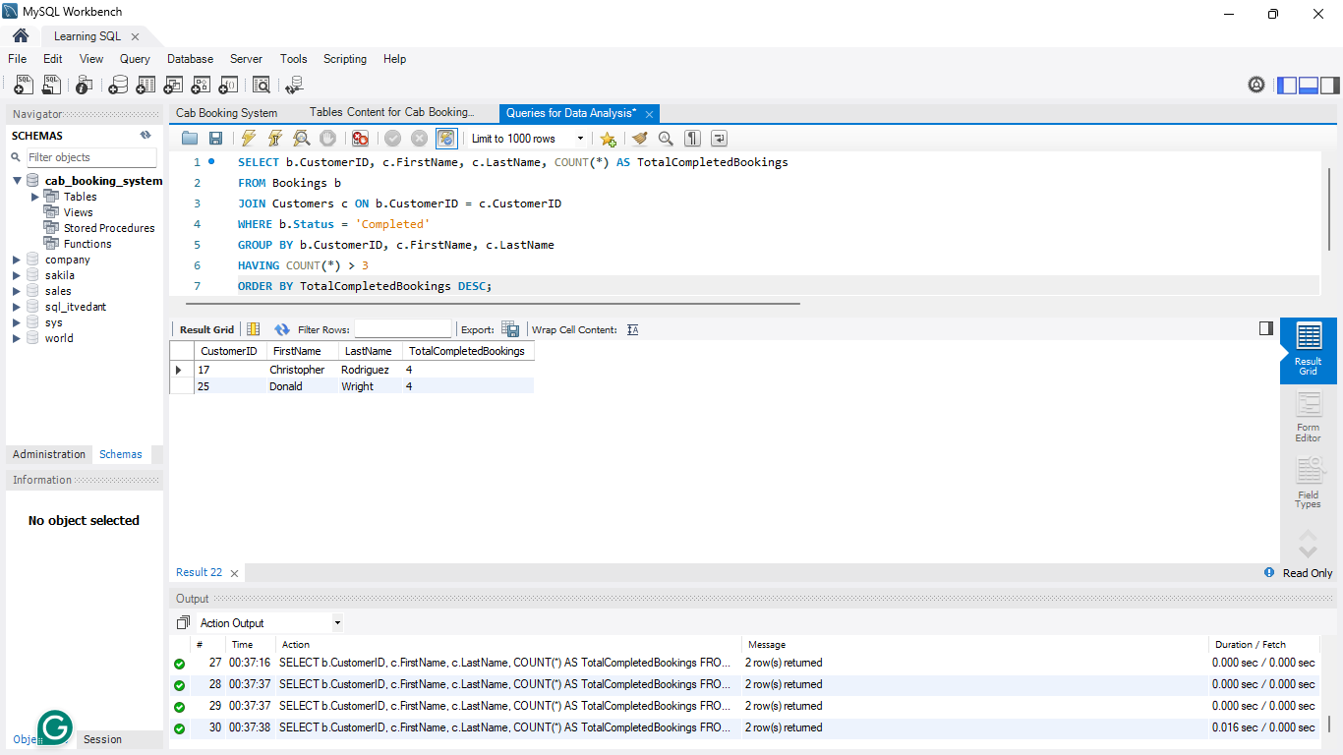
SQL query to get the total number of completed bookings for each customer (only those with more than 3 completed bookings):
SELECT b.CustomerID, c.FirstName, c.LastName, COUNT(*) AS TotalCompletedBookings
FROM Bookings b
JOIN Customers c ON b.CustomerID = c.CustomerID
WHERE b.Status = ‘Completed’
GROUP BY b.CustomerID, c.FirstName, c.LastName
HAVING COUNT (*) > 3
ORDER BY TotalCompletedBookings DESC;
Query Explanation:

Slide 46
SQL query to get the total number of completed bookings for each customer (only those with more than 3 completed bookings):
SELECT b.CustomerID, c.FirstName, c.LastName, COUNT(*) AS TotalCompletedBookings
FROM Bookings b
JOIN Customers c ON b.CustomerID = c.CustomerID
WHERE b.Status = ‘Completed’
GROUP BY b.CustomerID, c.FirstName, c.LastName
HAVING COUNT (*) > 3
ORDER BY TotalCompletedBookings DESC;
We count only completed bookings for each customer.
Query Explanation:

Slide 47
SQL query to get the total number of completed bookings for each customer (only those with more than 3 completed bookings):
SELECT b.CustomerID, c.FirstName, c.LastName, COUNT(*) AS TotalCompletedBookings
FROM Bookings b
JOIN Customers c ON b.CustomerID = c.CustomerID
WHERE b.Status = ‘Completed’
GROUP BY b.CustomerID, c.FirstName, c.LastName
HAVING COUNT (*) > 3
ORDER BY TotalCompletedBookings DESC;
We count only completed bookings for each customer.
GROUP BY ensures we count bookings per customer.
Query Explanation:

Slide 48
SQL query to get the total number of completed bookings for each customer (only those with more than 3 completed bookings):
SELECT b.CustomerID, c.FirstName, c.LastName, COUNT(*) AS TotalCompletedBookings
FROM Bookings b
JOIN Customers c ON b.CustomerID = c.CustomerID
WHERE b.Status = ‘Completed’
GROUP BY b.CustomerID, c.FirstName, c.LastName
HAVING COUNT (*) > 3
ORDER BY TotalCompletedBookings DESC;
We count only completed bookings for each customer.
GROUP BY ensures we count bookings per customer.
Query Explanation:
HAVING COUNT(*) > 3 filters out bookings per customer.

Slide 49
SQL query to get the total number of completed bookings for each customer (only those with more than 3 completed bookings):
SELECT b.CustomerID, c.FirstName, c.LastName, COUNT(*) AS TotalCompletedBookings
FROM Bookings b
JOIN Customers c ON b.CustomerID = c.CustomerID
WHERE b.Status = ‘Completed’
GROUP BY b.CustomerID, c.FirstName, c.LastName
HAVING COUNT (*) > 3
ORDER BY TotalCompletedBookings DESC;
We count only completed bookings for each customer.
GROUP BY ensures we count bookings per customer.
Query Explanation:
HAVING COUNT(*) > 3 filters out bookings per customer.
ORDER BY TotalCompletedBookings DESC sorts results from most to least frequent customers.

Slide 50
Insights After running the Query:
Only two customers have completed more than three rides :
Christopher Rodriguez (4 rides)
Donald Wright (4 rides)
A loyalty program or incentives could be introduced to increase repeat bookings.

Slide 51
Who are the top 5 drivers with the highest average ratings?
To counter this question we had to run the following SQL query to Analise the top 5 drivers with highest average ratings.

Slide 52
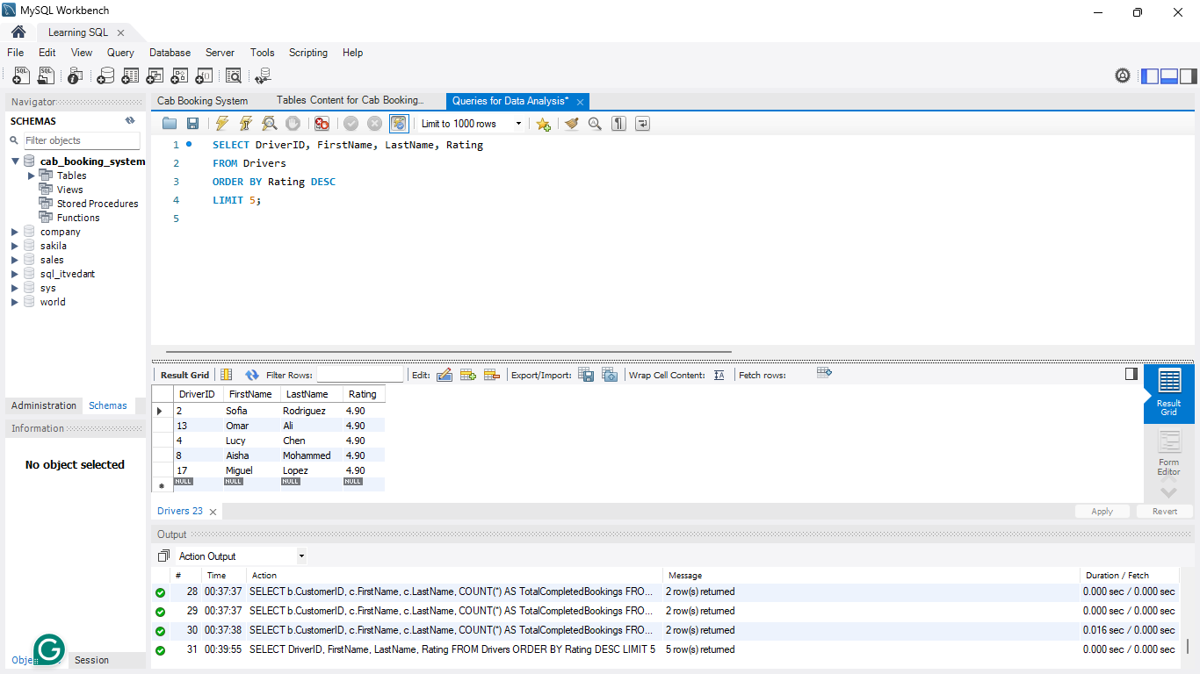
SQL query to get the top 5 Drivers with the Highest Average Ratigs:
SELECT DriversID, FirstName, LastName, Rating
FROM Drivers
ORDER BY Rating DESC
LIMIT 5;
Query Explanation:

Slide 53
SQL query to get the top 5 Drivers with the Highest Average Ratigs:
SELECT DriversID, FirstName, LastName, Rating
FROM Drivers
ORDER BY Rating DESC
LIMIT 5;
Select DriverID, FirstName, LastName, and Rating.
Query Explanation:

Slide 54
SQL query to get the top 5 Drivers with the Highest Average Ratigs:
SELECT DriversID, FirstName, LastName, Rating
FROM Drivers
ORDER BY Rating DESC
LIMIT 5;
Select DriverID, FirstName, LastName, and Rating.
Query Explanation:
Orders the results by Rating in descending order (DESC).

Slide 55
SQL query to get the top 5 Drivers with the Highest Average Ratigs:
SELECT DriversID, FirstName, LastName, Rating
FROM Drivers
ORDER BY Rating DESC
LIMIT 5;
Select DriverID, FirstName, LastName, and Rating.
Query Explanation:
Orders the results by Rating in descending order (DESC).
Limits the output to the top 5 drivers.

Slide 56
Insights After running the Query:
The top five drivers with the highest average rating of 4.90/5 are :
Sofia Rodriguez
Omar Ali
Lucy Chen
Aisha Mohammed
Miguel Lopez
This highlights drivers who provide exceptional service, which can be used for rewards, training, or customer engagement programs.
Limits the output to the top 5 drivers.

Slide 57
What are the pickup and drop-off locations of all the Cabs? Also provide the License Plate of the cabs.
To counter this question we had to run the following SQL query to track all of our are cabs, along with there License Plate to identify them.

Slide 58
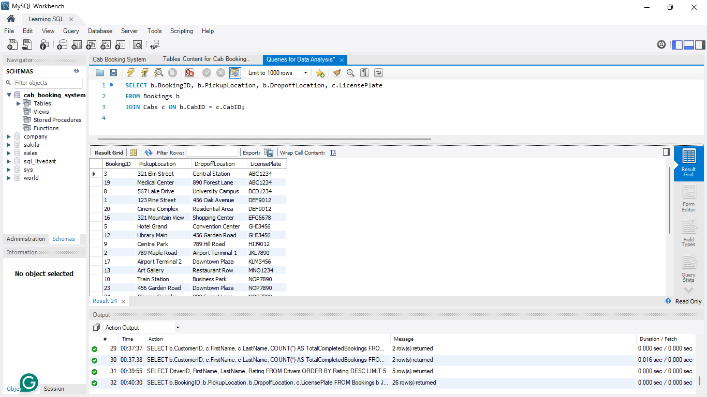
SQL query to get a List of All Bookings with PickupLocation, DropoffLocation, and LicensePlate:
SELECT b.BookingID, b.PickupLocation, b.DropoffLocation, c.LicensePlate
FROM Bookings b
JOIN Cabs c ON b.CabID = c.CabID;
Query Explanation:

Slide 59
SQL query to get a List of All Bookings with PickupLocation, DropoffLocation, and LicensePlate:
SELECT b.BookingID, b.PickupLocation, b.DropoffLocation, c.LicensePlate
FROM Bookings b
JOIN Cabs c ON b.CabID = c.CabID;
Joins Bookings (b) with Cabs (c) using CabID as the common key.
Query Explanation:

Slide 60
SQL query to get a List of All Bookings with PickupLocation, DropoffLocation, and LicensePlate:
SELECT b.BookingID, b.PickupLocation, b.DropoffLocation, c.LicensePlate
FROM Bookings b
JOIN Cabs c ON b.CabID = c.CabID;
Joins Bookings (b) with Cabs (c) using CabID as the common key.
Query Explanation:
Retrieves BookingID, PickupLocation, DropoffLocation, and LicensePlate.

Slide 61
Insights After running the Query:
Bookings are mapped with pickup and drop-off locations along with cab license plates.
This data can be used for tracking rides, customer safety, and regulatory compliance.

Slide 62
List of all drivers who are associated with any bookings including the drivers who might not have any bookings.
To counter this question we had to run the following SQL query to list the drivers who have bookings or NO bookings.

Slide 63
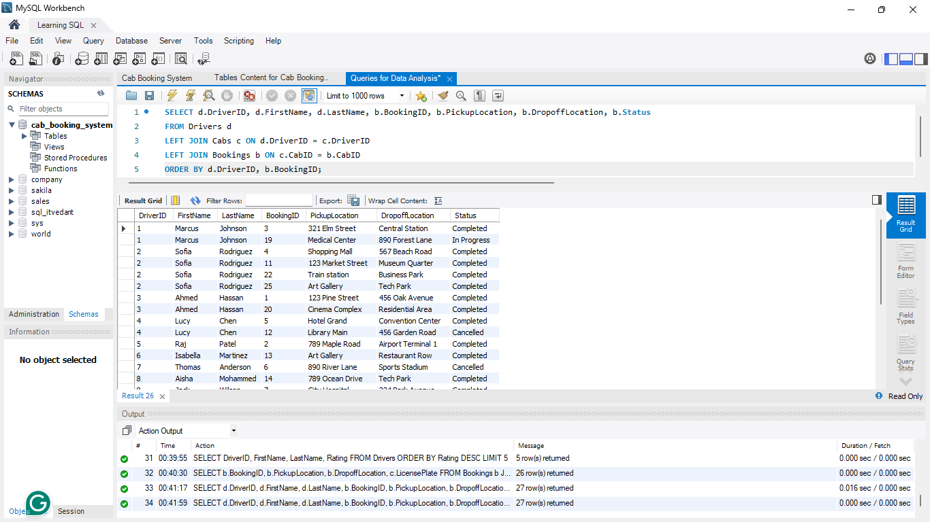
SQL query to get a List of All Drivers and Any Associated Bookings (Include Drivers with No Bookings)
SELECT d.DriverID, d.FirstName, d.LastName, b.BookingID, b.PickupLocation, b.DropoffLocation, b.Status
FROM Drivers d
LEFT JOIN Cabs c ON d.DriverID = c.DriverID
LEFT JOIN Cabs c ON c.CabID = b.CabID
ORDER BY d.DriverID, b.BookingID;
Query Explanation:

Slide 64
SQL query to get a List of All Drivers and Any Associated Bookings (Include Drivers with No Bookings)
SELECT d.DriverID, d.FirstName, d.LastName, b.BookingID, b.PickupLocation, b.DropoffLocation, b.Status
FROM Drivers d
LEFT JOIN Cabs c ON d.DriverID = c.DriverID
LEFT JOIN Cabs c ON c.CabID = b.CabID
ORDER BY d.DriverID, b.BookingID;
Uses a LEFT JOIN to include drivers even if they have on bookings.
Query Explanation:

Slide 65
SQL query to get a List of All Drivers and Any Associated Bookings (Include Drivers with No Bookings)
SELECT d.DriverID, d.FirstName, d.LastName, b.BookingID, b.PickupLocation, b.DropoffLocation, b.Status
FROM Drivers d
LEFT JOIN Cabs c ON d.DriverID = c.DriverID
LEFT JOIN Cabs c ON c.CabID = b.CabID
ORDER BY d.DriverID, b.BookingID;
Uses a LEFT JOIN to include drivers even if they have on bookings.
Joins Drivers (d) to Cabs (c) to Bookings (b).
Query Explanation:

Slide 66
SQL query to get a List of All Drivers and Any Associated Bookings (Include Drivers with No Bookings)
SELECT d.DriverID, d.FirstName, d.LastName, b.BookingID, b.PickupLocation, b.DropoffLocation, b.Status
FROM Drivers d
LEFT JOIN Cabs c ON d.DriverID = c.DriverID
LEFT JOIN Cabs c ON c.CabID = b.CabID
ORDER BY d.DriverID, b.BookingID;
Uses a LEFT JOIN to include drivers even if they have on bookings.
Joins Drivers (d) to Cabs (c) to Bookings (b).
Query Explanation:
Retrieves Drivers details and any associated bookings (if available).

Slide 67
SQL query to get a List of All Drivers and Any Associated Bookings (Include Drivers with No Bookings)
SELECT d.DriverID, d.FirstName, d.LastName, b.BookingID, b.PickupLocation, b.DropoffLocation, b.Status
FROM Drivers d
LEFT JOIN Cabs c ON d.DriverID = c.DriverID
LEFT JOIN Cabs c ON c.CabID = b.CabID
ORDER BY d.DriverID, b.BookingID;
Uses a LEFT JOIN to include drivers even if they have on bookings.
Joins Drivers (d) to Cabs (c) to Bookings (b).
Query Explanation:
Retrieves Drivers details and any associated bookings (if available).
ORDER BY d.DriverID, b.BookingID organizes results.

Slide 68
Insights After running the Query:
The case study identifies drivers who are associated with bookings and those who are not assigned any rides.
This can help in evaluating driver performance, availability, and potential overstaffing or underutilization issues.

Slide 69
What are the total distance covered by each cab?
To counter this question we had to run the following SQL query to calculate the total distance covered by each cab.

Slide 70
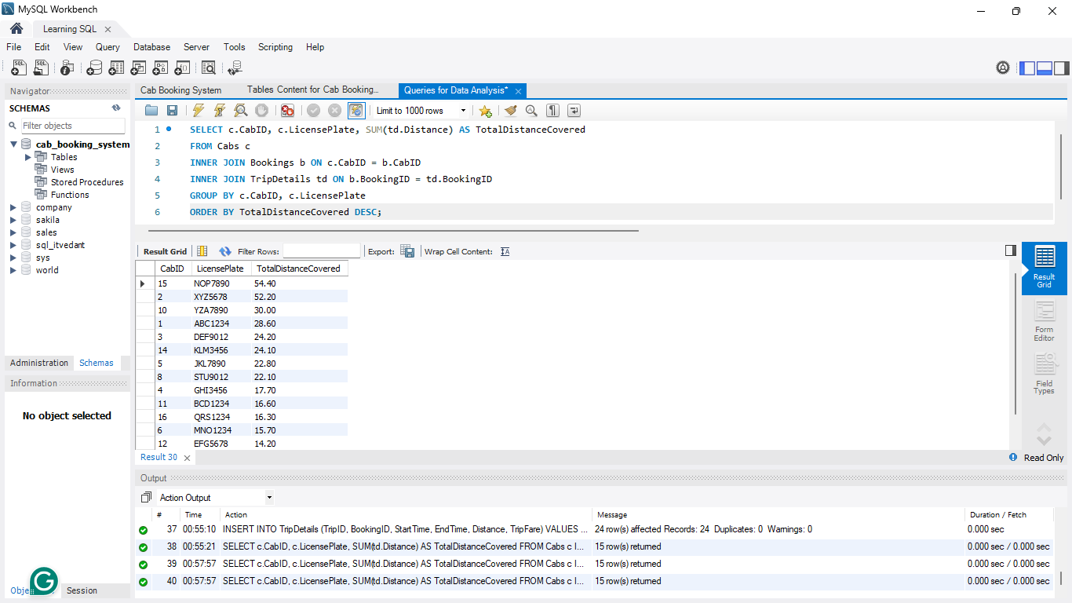
SQL query to get a List of All Drivers and Any Associated Bookings (Include Drivers with No Bookings)
SELECT c.CabID, c.LicensePlate, SUM(td.Distance) AS TotalDistanceCovered
FROM Cabs c
INNER JOIN Bookings b ON c.CabID = b.CabID
INNER JOIN TripDetails td ON b.BookingID = td.BookingID
GROUP BY c.CabID, c.LicensePlate
ORDER BY TotalDistanceCovered DESC;
Query Explanation:

Slide 71
SQL query to get a List of All Drivers and Any Associated Bookings (Include Drivers with No Bookings)
SELECT c.CabID, c.LicensePlate, SUM(td.Distance) AS TotalDistanceCovered
FROM Cabs c
INNER JOIN Bookings b ON c.CabID = b.CabID
INNER JOIN TripDetails td ON b.BookingID = td.BookingID
GROUP BY c.CabID, c.LicensePlate
ORDER BY TotalDistanceCovered DESC;
Joins Cabs to Bookings to TripDetails to track trips per cab.
Query Explanation:

Slide 72
SQL query to get a List of All Drivers and Any Associated Bookings (Include Drivers with No Bookings)
SELECT c.CabID, c.LicensePlate, SUM(td.Distance) AS TotalDistanceCovered
FROM Cabs c
INNER JOIN Bookings b ON c.CabID = b.CabID
INNER JOIN TripDetails td ON b.BookingID = td.BookingID
GROUP BY c.CabID, c.LicensePlate
ORDER BY TotalDistanceCovered DESC;
Joins Cabs to Bookings to TripDetails to track trips per cab.
Uses SUM(td.Distance) to calculate total distance covered per cab.
Query Explanation:

Slide 73
SQL query to get a List of All Drivers and Any Associated Bookings (Include Drivers with No Bookings)
SELECT c.CabID, c.LicensePlate, SUM(td.Distance) AS TotalDistanceCovered
FROM Cabs c
INNER JOIN Bookings b ON c.CabID = b.CabID
INNER JOIN TripDetails td ON b.BookingID = td.BookingID
GROUP BY c.CabID, c.LicensePlate
ORDER BY TotalDistanceCovered DESC;
Joins Cabs to Bookings to TripDetails to track trips per cab.
Uses SUM(td.Distance) to calculate total distance covered per cab.
Query Explanation:
Groups by CabID and LicensePlate.

Slide 74
SQL query to get a List of All Drivers and Any Associated Bookings (Include Drivers with No Bookings)
SELECT c.CabID, c.LicensePlate, SUM(td.Distance) AS TotalDistanceCovered
FROM Cabs c
INNER JOIN Bookings b ON c.CabID = b.CabID
INNER JOIN TripDetails td ON b.BookingID = td.BookingID
GROUP BY c.CabID, c.LicensePlate
ORDER BY TotalDistanceCovered DESC;
Joins Cabs to Bookings to TripDetails to track trips per cab.
Uses SUM(td.Distance) to calculate total distance covered per cab.
Query Explanation:
Groups by CabID and LicensePlate.
Orders by TotalDistanceCovered DESC (most-used cab first).

Slide 75
Insights After running the Query:
The dataset contains information on how much each cab has traveled in all assigned bookings.
This is useful for fleet management, cab maintenance schedules, and determining high-usage vehicles.

Slide 76
What are the completed bookings whose fare is higher than the average fare?
To counter this question we have to run the following SQL query so that we can know about the bookings whose fare is higher than the average fare with complete status.

Slide 77
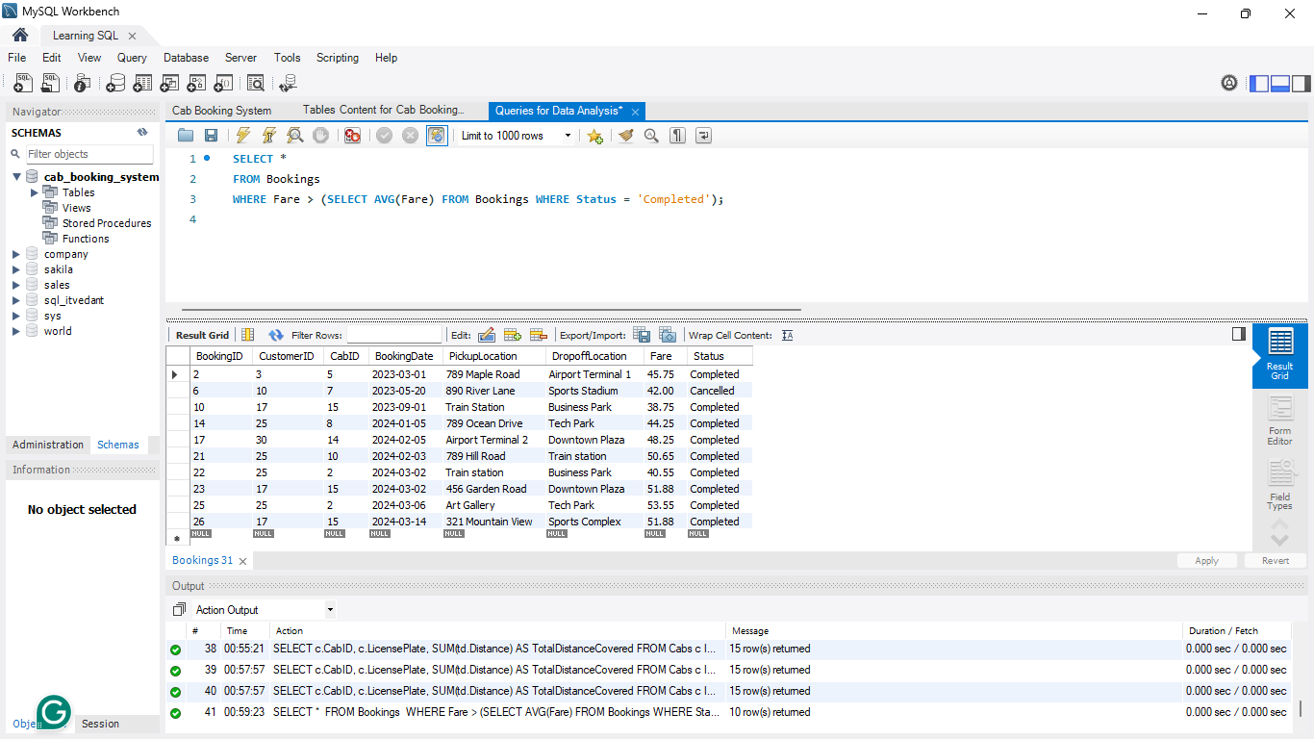
SQL query to find all Bookings Where the Fare is Higher Than the Average Fare for all Completed Bookings:
SELECT * FROM Bookings
WHERE Fare > (SELECT AVG(Fare) FROM Bookings WHERE Status = ‘Completed’);
Query Explanation:

Slide 78
SQL query to find all Bookings Where the Fare is Higher Than the Average Fare for all Completed Bookings:
SELECT * FROM Bookings
WHERE Fare > (SELECT AVG(Fare) FROM Bookings WHERE Status = ‘Completed’);
The subquery (SELECT AVG(Fare) FROM Bookings WHERE Status = ‘Completed’) calculates the average fare of only completed bookings.
Query Explanation:

Slide 79
SQL query to find all Bookings Where the Fare is Higher Than the Average Fare for all Completed Bookings:
SELECT * FROM Bookings
WHERE Fare > (SELECT AVG(Fare) FROM Bookings WHERE Status = ‘Completed’);
The subquery (SELECT AVG(Fare) FROM Bookings WHERE Status = ‘Completed’) calculates the average fare of only completed bookings.
Query Explanation:
The outer query selects all bookings where the Fare is greater than this average.

Slide 80
This indicates that certain routes or conditions contribute to higher fares.
Insights After running the Query:
There are 10 bookings where the fare is above the average fare and has a status of "Completed".
This indicates that certain routes or conditions contribute to higher fares.
Further analysis can help identify factors like peak hours, demand-surge pricing, or long-distance rides.
The outer query selects all bookings where the Fare is greater than this average.

Slide 81
List the drivers along with the customers whom they are associated with and the pickup and drop-off location.
To counter this question we had to run the following SQL query so that we can know all the details about the bookings that we had.

Slide 82
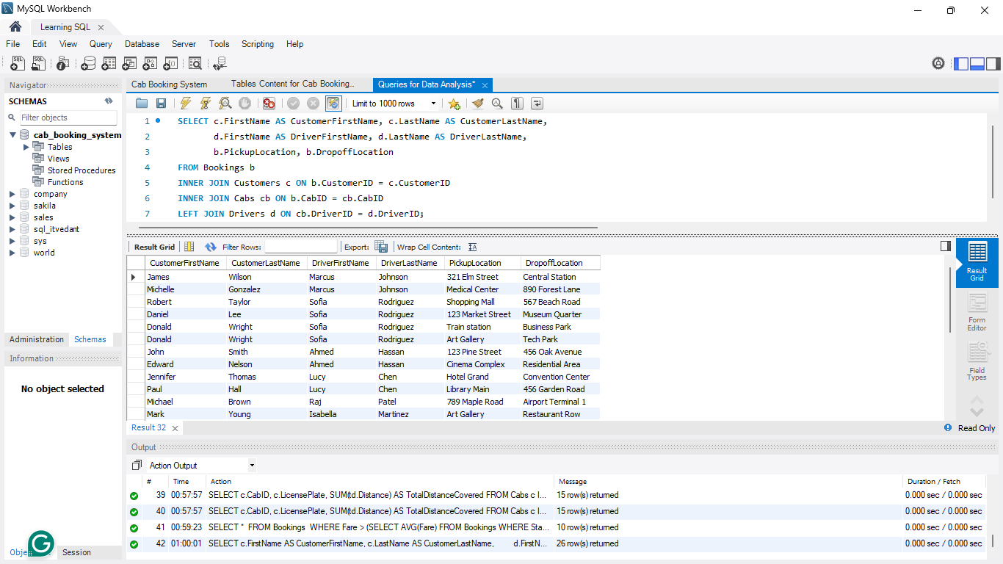
SQL query to find List Customer and Driver Names Along with Pickup and Dropoff Locations for All Bookings:
SELECT c.FirstName AS CustomerFirstName, c.LastName AS CustomerLastName, d.FirstName AS DriverFirstName, d.LastName AS DriverLastName, b.PickupLocation, b.DropoffLocation
FROM Bookings b
INNER JOIN Customers c ON b.CustomerID = c.CustomerID
INNER JOIN Cabs cb ON b.CabID = cb.CabID
LEFT JOIN Drivers d ON cb.DriverID = d.DriverID;
Query Explanation:

Slide 83
SQL query to find List Customer and Driver Names Along with Pickup and Dropoff Locations for All Bookings:
SELECT c.FirstName AS CustomerFirstName, c.LastName AS CustomerLastName, d.FirstName AS DriverFirstName, d.LastName AS DriverLastName, b.PickupLocation, b.DropoffLocation
FROM Bookings b
INNER JOIN Customers c ON b.CustomerID = c.CustomerID
INNER JOIN Cabs cb ON b.CabID = cb.CabID
LEFT JOIN Drivers d ON cb.DriverID = d.DriverID;
INNER JOIN Customers c ON b.CustomerID =c. CustomerID ensures we get only bookings that have a valid customer.
Query Explanation:

Slide 84
SQL query to find List Customer and Driver Names Along with Pickup and Dropoff Locations for All Bookings:
SELECT c.FirstName AS CustomerFirstName, c.LastName AS CustomerLastName, d.FirstName AS DriverFirstName, d.LastName AS DriverLastName, b.PickupLocation, b.DropoffLocation
FROM Bookings b
INNER JOIN Customers c ON b.CustomerID = c.CustomerID
INNER JOIN Cabs cb ON b.CabID = cb.CabID
LEFT JOIN Drivers d ON cb.DriverID = d.DriverID;
INNER JOIN Customers c ON b.CustomerID =c. CustomerID ensures we get only bookings that have a valid customer.
INNER JOIN Cabs cb ON b.CabID = cb.CabID ensures we link each booking to its cab.
Query Explanation:

Slide 85
SQL query to find List Customer and Driver Names Along with Pickup and Dropoff Locations for All Bookings:
SELECT c.FirstName AS CustomerFirstName, c.LastName AS CustomerLastName, d.FirstName AS DriverFirstName, d.LastName AS DriverLastName, b.PickupLocation, b.DropoffLocation
FROM Bookings b
INNER JOIN Customers c ON b.CustomerID = c.CustomerID
INNER JOIN Cabs cb ON b.CabID = cb.CabID
LEFT JOIN Drivers d ON cb.DriverID = d.DriverID;
INNER JOIN Customers c ON b.CustomerID =c. CustomerID ensures we get only bookings that have a valid customer.
INNER JOIN Cabs cb ON b.CabID = cb.CabID ensures we link each booking to its cab.
Query Explanation:
LEFT JOIN Drivers d ON cb.DriveID = D.DriverID ensures we fetch driver details even if they are missing (e.g., in case of unassigned bookings).

Slide 86
SQL query to find List Customer and Driver Names Along with Pickup and Dropoff Locations for All Bookings:
SELECT c.FirstName AS CustomerFirstName, c.LastName AS CustomerLastName, d.FirstName AS DriverFirstName, d.LastName AS DriverLastName, b.PickupLocation, b.DropoffLocation
FROM Bookings b
INNER JOIN Customers c ON b.CustomerID = c.CustomerID
INNER JOIN Cabs cb ON b.CabID = cb.CabID
LEFT JOIN Drivers d ON cb.DriverID = d.DriverID;
INNER JOIN Customers c ON b.CustomerID =c. CustomerID ensures we get only bookings that have a valid customer.
INNER JOIN Cabs cb ON b.CabID = cb.CabID ensures we link each booking to its cab.
Query Explanation:
LEFT JOIN Drivers d ON cb.DriveID = D.DriverID ensures we fetch driver details even if they are missing (e.g., in case of unassigned bookings).
The query selects: Customer First & Last Name, Driver First & Last Name, Pickup and Dropoff Locations.

Slide 87
Insights After running the Query:
The data provides details of all customer journeys, including assigned drivers and pickup/drop-off locations.
This information helps in understanding travel patterns, popular routes, and customer preferences.

Slide 88


Key Business Insights and Recommendations

Slide 89
Optimize Driver Allocation
Encourage Customer Retention
Key Business Insights and Recommendations
Some drivers have no bookings, suggesting imbalanced driver availability.
Only two customers have taken more than 3 rides.
Consider better scheduling or incentivizing underutilized drivers.
Introduce loyalty programs, discounts, or referral benefits to increase repeat bookings.

Slide 90

Optimize Driver Allocation
Encourage Customer Retention
Enhance Cab Fleet Management
Some drivers have no bookings, suggesting imbalanced driver availability.
Only two customers have taken more than 3 rides.
Track high-usage vehicles to schedule maintenance and prevent breakdowns.
Consider better scheduling or incentivizing underutilized drivers.
Introduce loyalty programs, discounts, or referral benefits to increase repeat bookings.
Consider expanding sedan options if customer demand favors diverse vehicle types.

Slide 91


Encourage Customer Retention
Enhance Cab Fleet Management
Track high-usage vehicles to schedule maintenance and prevent breakdowns.
Consider expanding sedan options if customer demand favors diverse vehicle types.
Monitor Fare Pricing Strategy
Only two customers have taken more than 3 rides.
Introduce loyalty programs, discounts, or referral benefits to increase repeat bookings.
With only 4 high-fare rides, analyze peak-hour pricing, demand-based fare adjustments, and premium services.

Slide 92

Monitor Fare Pricing Strategy
Enhance Cab Fleet Management
Utilize the top-rated drivers to lead customer service training programs.
Monitor Fare Pricing Strategy
Offer bonuses or incentives to highly-rated drivers to encourage continued excellence.
With only 4 high-fare rides, analyze peak-hour pricing, demand-based fare adjustments, and premium services.
Consider expanding sedan options if customer demand favors diverse vehicle types.
Track high-usage vehicles to schedule maintenance and prevent breakdowns.

Slide 93

With only 4 high-fare rides, analyze peak-hour pricing, demand-based fare adjustments, and premium services.
Improve Customer Experience via High-Rated Drivers
Leverage Ride Data for Route Optimization
Identify popular pickup/drop-off locations and peak hours to optimize cab availability.
Utilize the top-rated drivers to lead customer service training programs.
Potentially introduce dynamic pricing for high-demand routes.
Offer bonuses or incentives to highly-rated drivers to encourage continued excellence.
Monitor Fare Pricing Strategy

Slide 94

Improve Customer Experience via High-Rated Drivers
Utilize the top-rated drivers to lead customer service training programs.
Offer bonuses or incentives to highly-rated drivers to encourage continued excellence.
Leverage Ride Data for Route Optimization
Expand Marketing for New Customers
Since few repeat customers exist, aggressive customer acquisition strategies should be implemented.
Identify popular pickup/drop-off locations and peak hours to optimize cab availability.
Potentially introduce dynamic pricing for high-demand routes.
Utilize social media ads, partnerships, and first-time user discounts.

Slide 95

Expand Marketing for New Customers
Since few repeat customers exist, aggressive customer acquisition strategies should be implemented.
Utilize social media ads, partnerships, and first-time user discounts.
Leverage Ride Data for Route Optimization
Identify popular pickup/drop-off locations and peak hours to optimize cab availability.
Potentially introduce dynamic pricing for high-demand routes.

Slide 96
Conclusion
The case study highlights key areas for improving driver allocation, customer retention, fare management, and fleet efficiency. By leveraging these insights, the cab booking system can enhance operations, customer satisfaction, and profitability.

Slide 97

Thank You
For Your Attention
Cab Booking System Database Project [A demonstration of database structure and relationships using sample data]
Domains Covered:
Database Schema Design
Data Relationships & Integrity
SQL Implementation
Booking Management System
Customer Feedback Analytics
Tahiruddin
Date: 20 February 2025
"Turning Data into Drive: Where Every Booking Tells a Story"

